Slide 1

DTM-002 C5
BY- Chandana MN
Aishwarya Rajesh
Prem Kumar S
Adesh Dnyandeo Raut
Faculty Guide
Dr. Sumit Kumar Banshal
Prof. Swetha Shekarappa G (L)
Dr. Athul Joseph

Slide 2
Women Safety Application

Slide 3

Introduction
Women's safety is a major issue in today's world. With the rise in crimes against women, it has become imperative to take steps towards ensuring their safety. One such step is the development of women's safety apps that can help women in times of distress.

Slide 4
"Empowering women with an innovative safety app for a secure and fearless life."

Slide 5

Problem Statement
Despite significant progress in gender equality and women's rights, women continue to face safety challenges in various aspects of their lives. Incidents of harassment, assault, and violence against women persist in public spaces, workplaces, and educational institutions.
Existing safety measures often fall short in providing immediate and effective assistance during emergencies, leaving women feeling vulnerable and unprotected.
Therefore, there is an urgent need for a comprehensive and user-friendly Women Safety App that empowers women with proactive safety features, real-time support, and access to emergency services to ensure their safety and peace of mind in all situations.

Slide 6

Objective
Women can now use an app that ensures their safety. The person is then able to identify and call on resources to help them out of dangerous situations.
In addition to reducing risk, these help us identify the location of those in danger, as well as bring assistance.
The main purpose of this app is to provide awareness to women of critical situations at the right time. Generally, users can activate this service by adding emergency contacts using the emergency contacts icon in the app.

Slide 7

Features of the Women Safety Application
Real-time location tracking
Emergency contact and SOS button
Personal safety tips and resources

Slide 8

Proposed System
The proposed system will be implemented with the help of the android application. Which will alert the nearby people who have this application by sending alert messages to them and alert sound in the guardian mobile on shaking off the victim's mobile.
Also sends messages and alert sounds to the saved contacts in the application. Which also shows the location of the victim with the help of a GPS tracker system.
Which also makes a sound in the registered user's mobile when his/her mobile is in silent mode

Slide 9
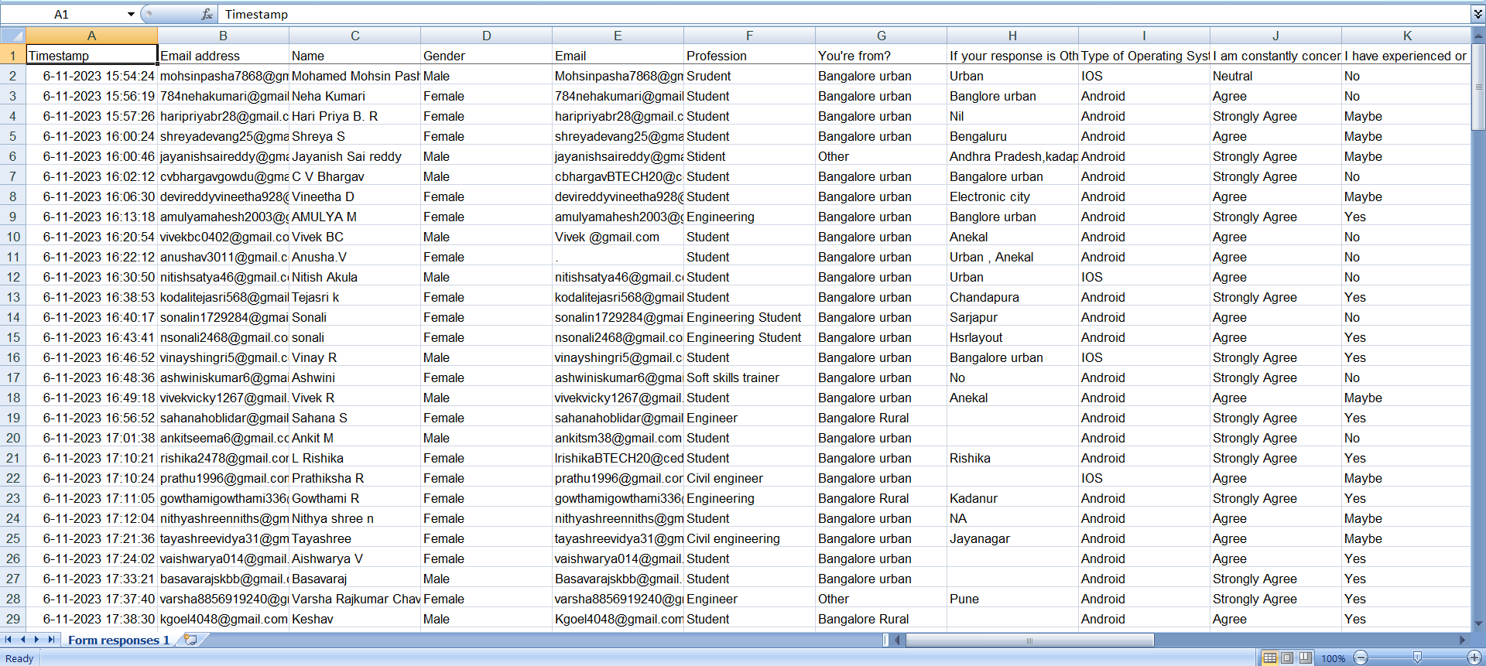
Survey

Slide 10
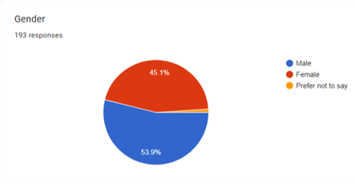
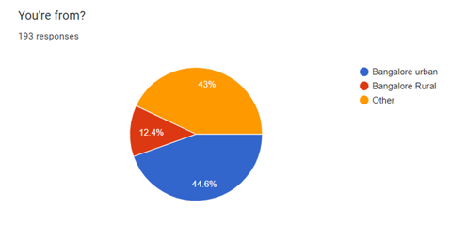

Slide 11
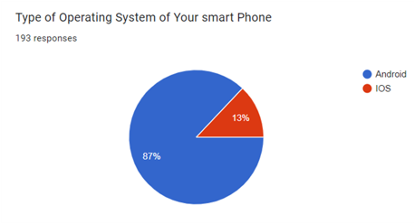
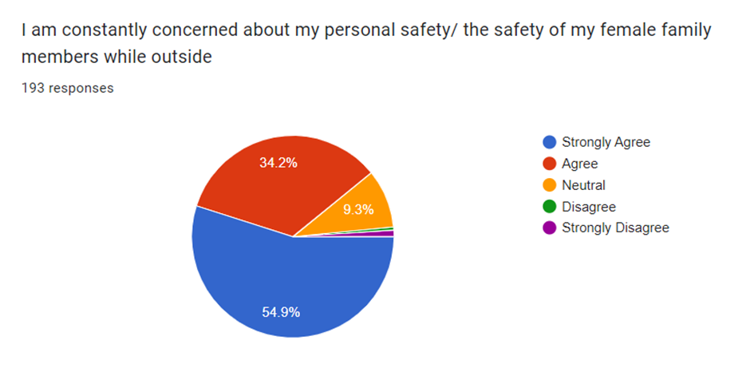

Slide 12
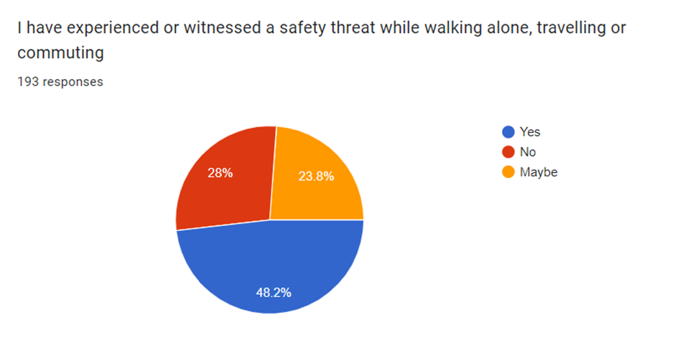
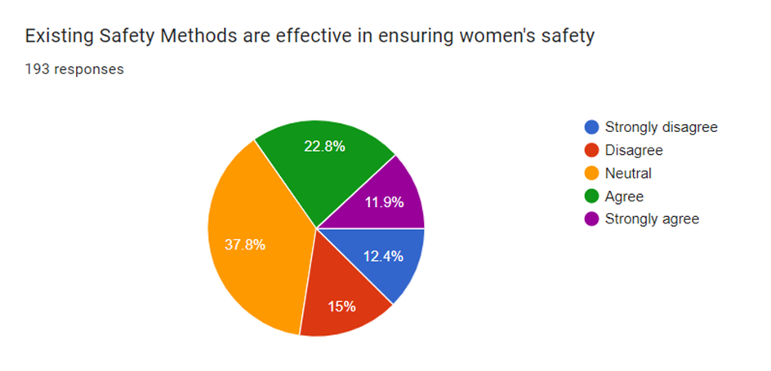

Slide 13
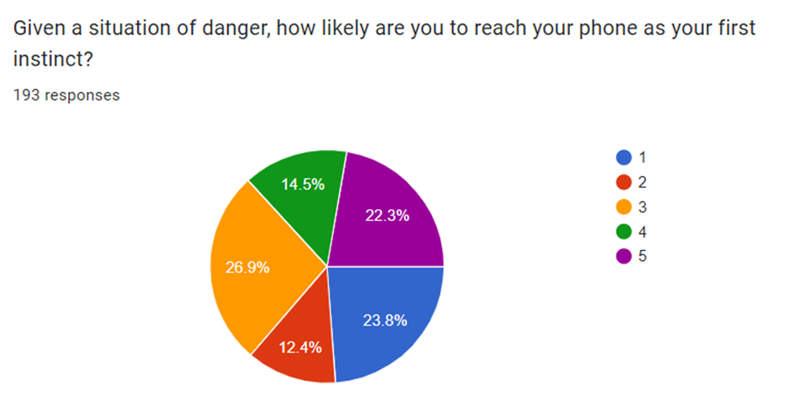
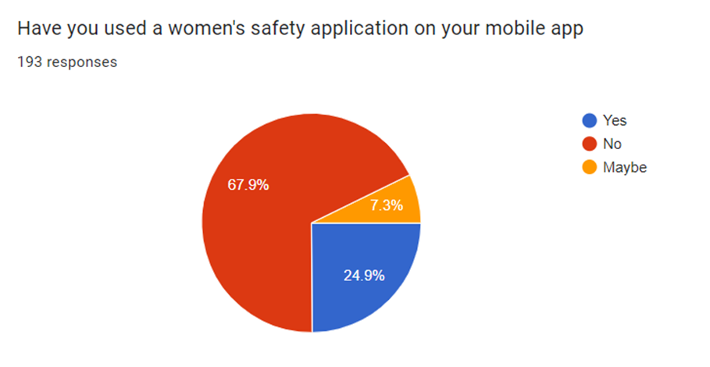

Slide 14
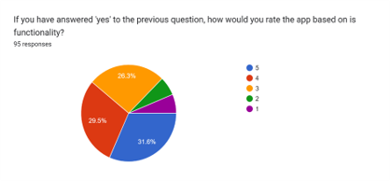
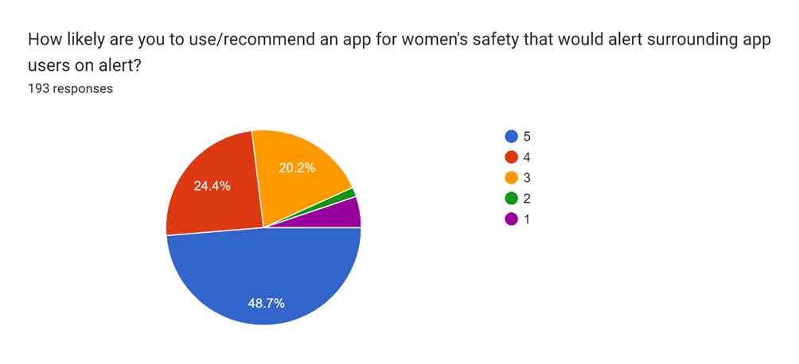

Slide 15
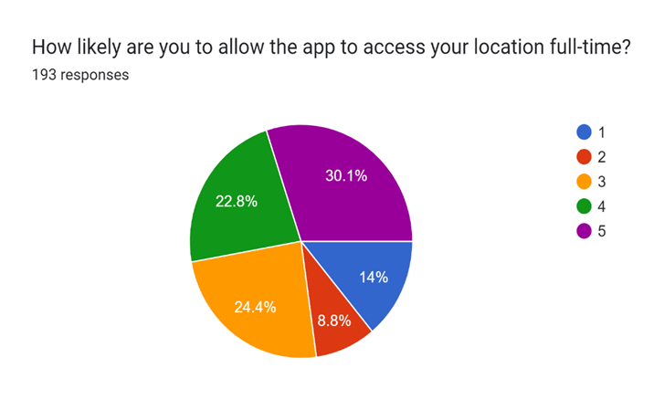
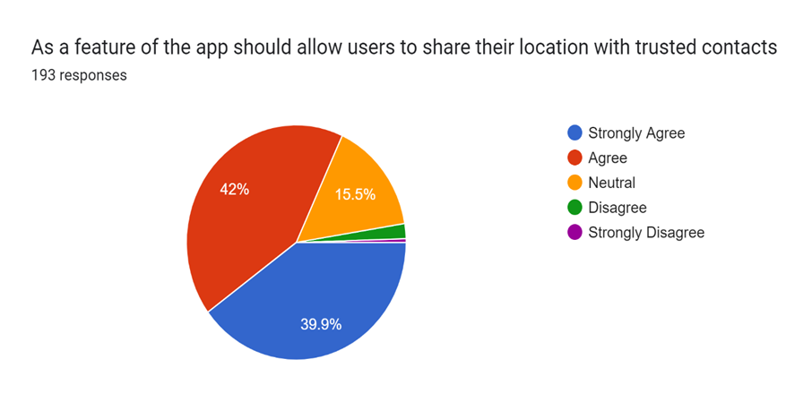

Slide 16
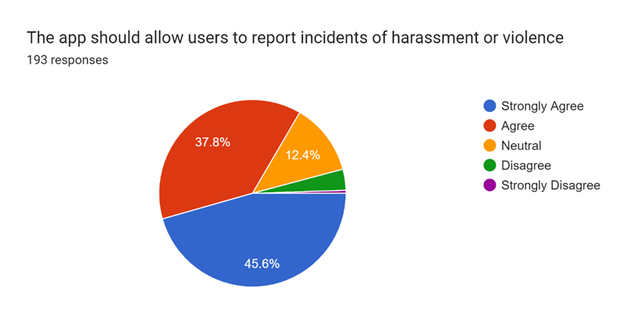
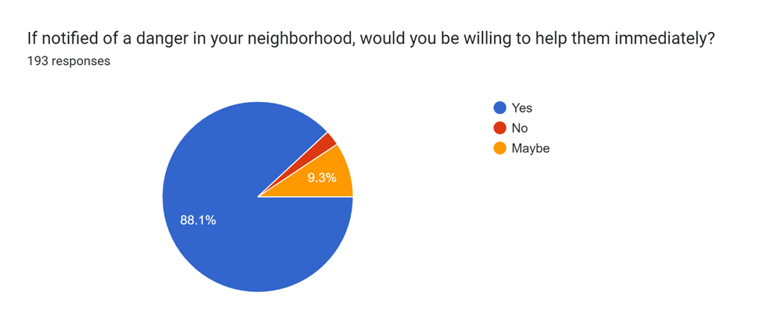

Slide 17
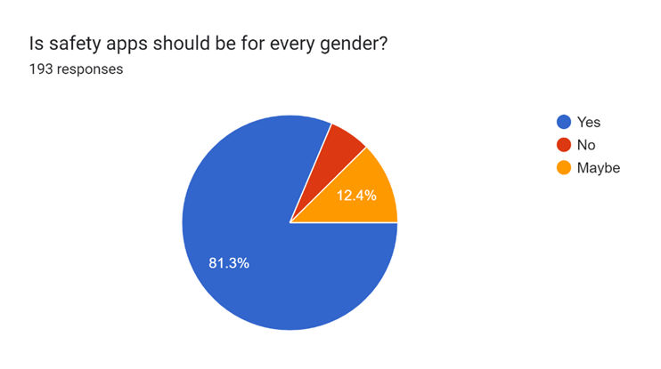
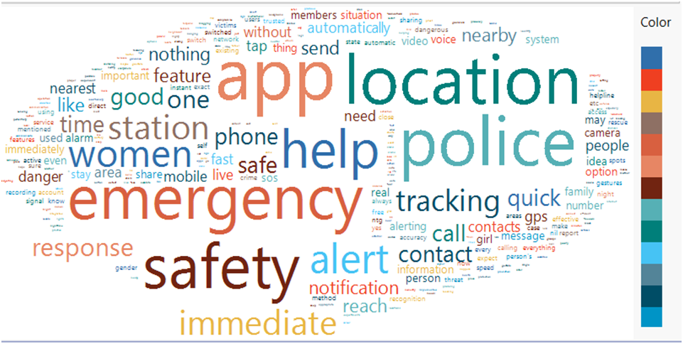

Slide 18

ANDROID STUDIO
Android Studio is the official Integrated Development Environment (IDE) for android application development. Android Studio provides more features that enhance our productivity while building Android apps.
Android Studio was announced on 16th May 2013 at the Google I/O conference as an official IDE for Android app development.
Since 7th May 2019, Kotlin is Google's preferred language for Android application development. Besides this, other programming languages are supported by Android Studio.
Features of Android Studio
•It has a flexible Gradle-based build system.
•It has a fast and feature-rich emulator for app testing.
•Android Studio has a consolidated environment where we can develop for all Android devices.
•Apply changes to the resource code of our running app without restarting the app.

Slide 19
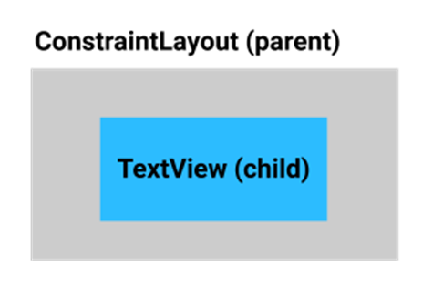
XML
XML stands for eXtensible Markup Language, which is a way of describing data using a text-based document. Because XML is extensible and very flexible, it's used for many different things, including defining the UI layout of Android apps.
The UI for an Android app is built as a containment hierarchy of components (widgets), and the on-screen layouts of those components. Note those layouts are UI components themselves.
You describe the view hierarchy of UI elements on the screen. For example, a ConstraintLayout (the parent) can contain Buttons, TextViews, ImageViews, or other views (the children). Remember, ConstraintLayout is a subclass of ViewGroup. It allows you to position or size child views in a flexible manner.

Slide 20

BASIC LAYOUT DESIGN

Slide 21
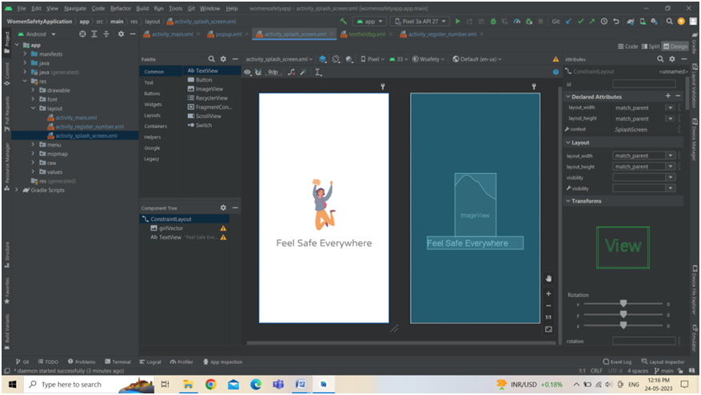
Flash screen design layout

Slide 22
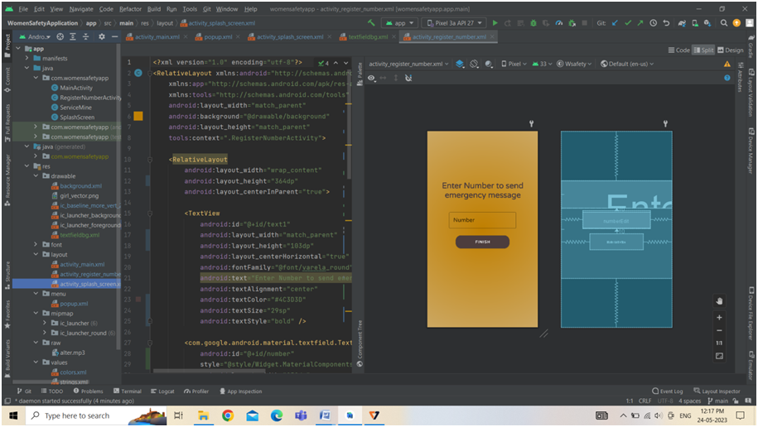
Register number layout

Slide 23
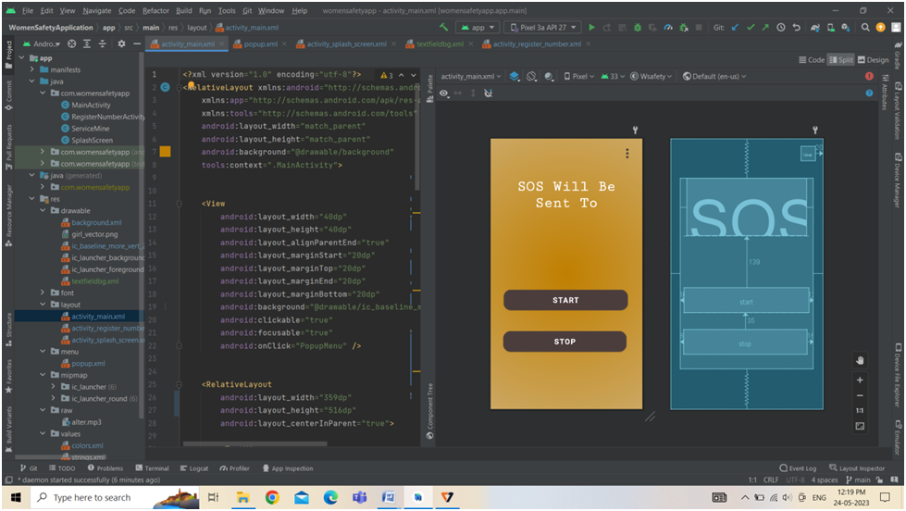
Main Menu Layout

Slide 24
Difference Between our app and another app
Another Application
Our Application
•Real-time location tracking :- bSafe
•Emergency contact and SOS button :- Circle of 6, Shake2Safety
•Personal safety tips and resources :- My Safetipal
•Real time location tracking
•Emergency contact and SOS button
•Personal Safety tips and resources
•Video calling features
•Audio recording

Slide 25

Conclusion
In conclusion, the women safety application is an essential tool for ensuring the safety of women. With its real-time location tracking, emergency contacts, and SOS button, women can feel safer in their everyday lives

Slide 26

Thank you

